Slide 2
Objective
Explain the role of ADO.NET
Describe data access architecture in .NET
Differentiate between DAO, RDO, ADO and ADO.NET
List the benefits of ADO.NET 2.0
Describe the disconnected data access approach
Notes:
Explain : to make something clear or easy to understand by describing or giving information about it
Benefit : a helpful or good effect, or something intended to help
Approach : to come near or nearer to something or someone in space, time, quality, or amount

Slide 3
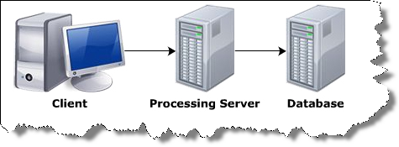
What is Database ?
Database is a collection of related records.
The information in DB is stored in such a way that it is easier to access, manage, and update the data.
Data from the DB can be accessed using any one of the following architectures:
Single-tier architecture
Two-tier architecture
Three-tier architecture

Slide 4
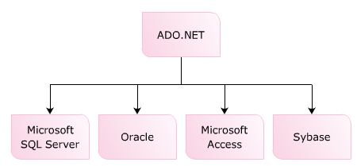
ADO.NET
Is the data access technology, which allows to access data from various data sources.
Is a part of .NET Framework:
The technology can be used for all .NET-base applications.
Supports disconnected data architecture:
Connection to the data source is established only required.
Use XML to interact with the DB:
All the data in the DB is converted into XML format for DB related operations.
Notes:
Disconnected : Mở/đóng kết nối tự động
Connected : Thiết lập kết nối phải tự kết nối – không tự động
Ưu điểm :
Web : Disconnected – Có nhiều request gửi cho máy chủ nên kết nối tự động sẽ tốt hơn. Châm hơn Connected – Bởi vì connected duy trì cho đến khi close

Slide 5
ADO.NET Features
Asynchronous processing:
Enable time-consuming application running in the background.
Multiple Active Result Sets (MARS):
Allow to execute multiple batches in a connection.
XML Data support
Bulk copy operations:
Allow to copy large files into tables or views
Batch processing
Tracing:
Monitor the execution of code → identify problems when executing code and fix them.
Connection pooling control:
Collects all the opened DB connections in a connection pool.
Get a connection from the pool for client rather than create new one.
Notes:
Asynchronous : not happening or done at the same time or speed

Slide 6
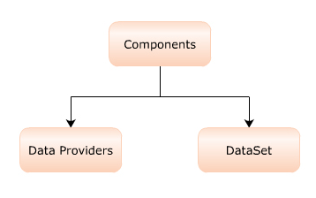
Data Access Architecture
The two important components of ADO.NET used for processing the data in DB are:
Data providers:
Provide and maintain connection to the DB
Dataset :
Is the required portion in database that is extracted and maintained in the form of a table as a local copy in the client system.
Notes:
Data providers : Thiết lập và duy trì kết nối csdl
Dataset : Lấy dữ liệu từ db source

Slide 7
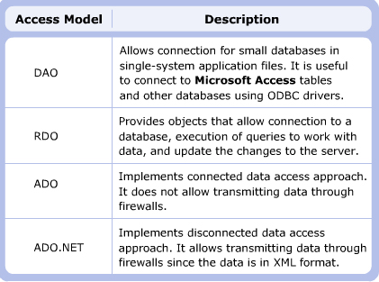
Data Access Models
Notes:
Data Access Object : DAO

Slide 8
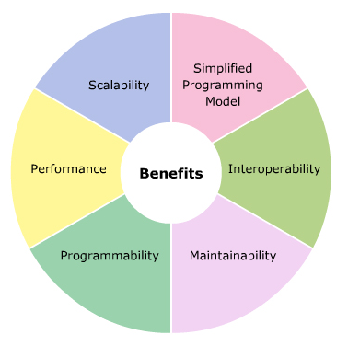
Benefits of ADO.NET
Simplified Programming Model
Interoperability:
XML is the default format used for transmitting datasets across network, any component can read XML format is able to process data.
Maintainability
Programmability
Performance
Does not require data-type conversion while transmitting data through the tier.
Scalability

Slide 9
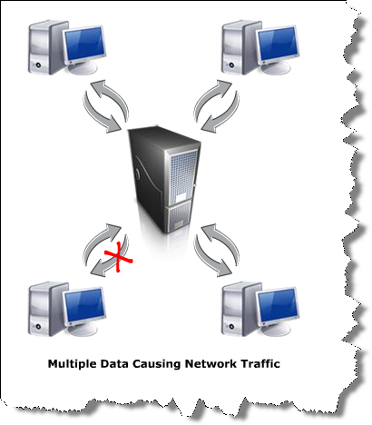
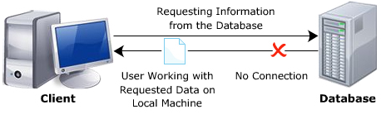
Data Access Models of ADO.NET
Connected data access:
Connection to the DB is established when requested by an application.
This connection is kept open till the application is closed.
Disconnected data access:
Connection to the DB is established when the application forwards a request.
Once the request is processed, connection is automatically closed.

Slide 10
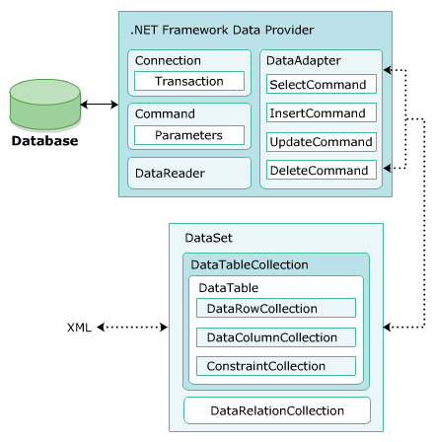
Data Access Components
ADO.NET provides two components to access and manipulate data:
.NET Framework data provider
The DataSet
The objects associated with ADO.NET technology are:
Command
Connection
DataAdapter
DataReader - Connected
DataSet - Connected
DataProvider

Slide 11
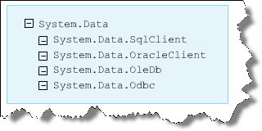
Data Provider
Used for providing and maintaining connection to the database
Allows to perform different operations in the database:
.NET Framework Data Provider for SQL Server
.NET Framework Data Provider for OLE DB
.NET Framework Data Provider for ODBC
.NET Framework Data Provider for Oracle

Slide 12
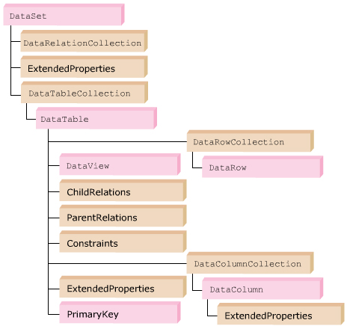
DataSet
Used to display and update data.
Used for retrieving data from multiple sources.
Can perform extensive processing on the data without having open connection to the server.

Slide 13
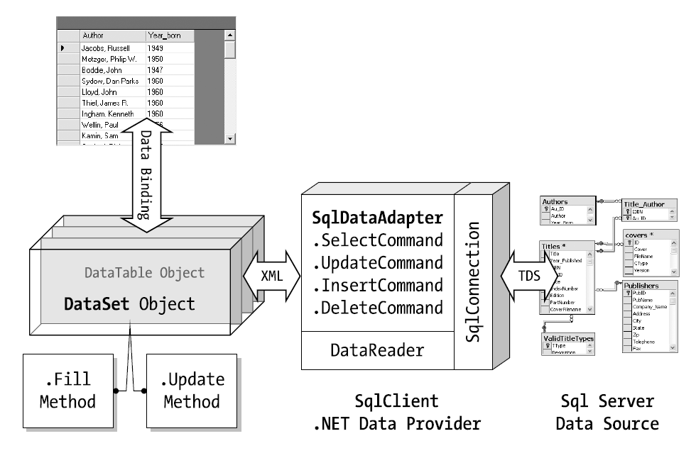
DataSet

Slide 14
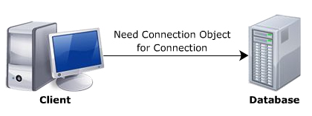
Connection
Allows to create a connection between application & DB.
In ADO.NET, a connection to SQL Server and OLE DB data source is established using the following connection class:
SqlConnection
OleDbConnection
Properties | ConnectionString, State
Methods | CreateCommand, Open, Close
Event | StateChange
string strConnect = “server=(local);database=pubs;uid=sa;pwd=sa”;
SqlConnection con = new SqlConnection(strConnect);

Slide 15
Command
Enable to execute a command against a data source:
Make a call to a stored procedure
Execute SQL statements: INSERT, DELETE, UPDATE and SELECT
Is specific to the data provider used in a connection:
SqlComand:
Specifies the types of operation performed with the SQL Server.
OleDbCommand:
Specifies statements, stored procedures performed with any data source by using OLE DB provider.
Properties | CommandText, Connection, CommandType, CommandTimeout
Methods | ExecuteNonQuery, ExecuteReader, ExecuteScalar, ExecuteXMLReader

Slide 16

DataAdapter
A bridge between a DataSet and a DataSource:
Fill() method: fill DataSet from DataSource
Update() method: INSERT,UPDATE or DELETE data from data source
There are many kinds of DataAdapter:
OleDbDataAdapter
SqlDataAdapter
OdbcDataAdapter
OracleDataAdapter

Slide 17
DataReader
Reads a stream of data from the DB.
Provides a forward-only, read-only stream of data :
Increases the application performance.
However, the DataReader object requires an exclusive use of an open connection object for its whole life span.
SqlDataReader reader = commandObj . ExecuteReader();

Slide 18
Summary
ADO.NET is a data access technology – supports disconnected data architecture
A data provider establishes and maintains connection to the database. The .NET Framework provides various data providers which are used for SQL Server, OLE DB, ODBC, Oracle data sources.
.NET Framework Data Providers and Dataset are used for accessing data source and then storing the retrieved records into tables : Connection, Command, DataAdapter, DataReader

